Slide 1
JNCIS-ENT
Tunnels

Slide 2
IP in IP Tunneling
3
IP traffic tunneling

Slide 3
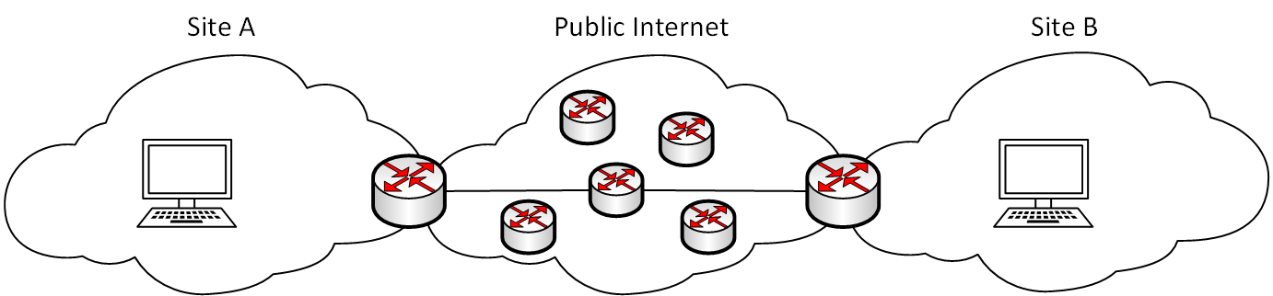
IP-IP vs. GRE
IP-IP tunneling is much like GRE tunneling except it will only tunnel IP traffic
IP-IP tunnels do not use any additional header except an inner and outer IP header
Uses ip-x/x/x interface, otherwise configuration is identical to GRE tunnels
IP header
TCP/UDP/Upper protocol header
Payload
Inner IP header
TCP/UDP/Upper protocol header
Payload
Outer IP header
IP header
TCP/UDP/Upper protocol header
Payload

Slide 4
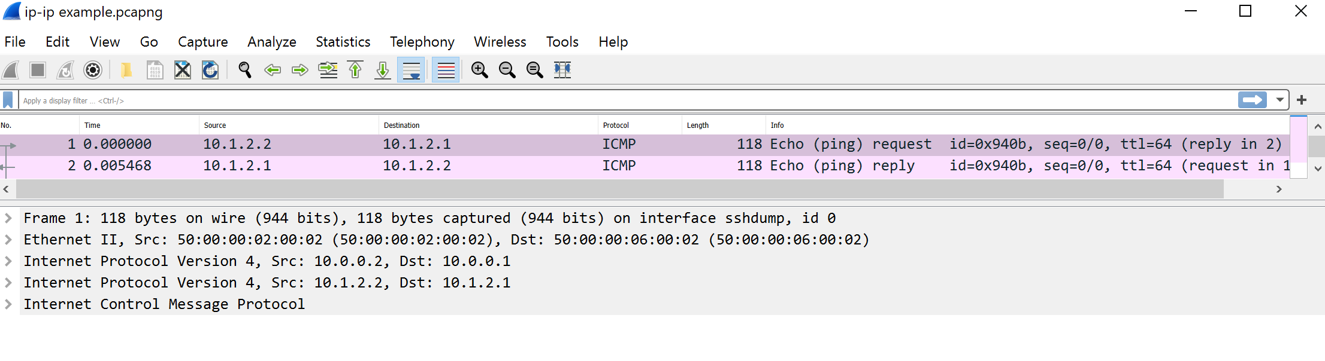
IP-IP

Slide 5
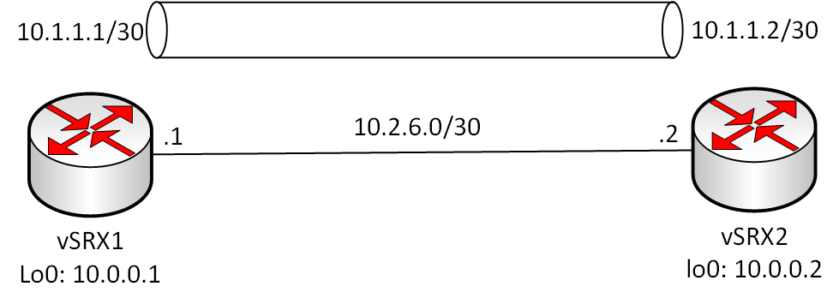
Configuring an IP-IP Tunnel
lab@vSRX1> show configuration interfaces ip-0/0/0
unit 0 {
tunnel {
source 10.0.0.1;
destination 10.0.0.2;
}
family inet {
address 10.1.1.1/30;
}
}
lab@vSRX2> show configuration interfaces ip-0/0/0
unit 0 {
tunnel {
source 10.0.0.2;
destination 10.0.0.1;
}
family inet {
address 10.1.1.2/30;
}
}

